Slide 1
Image Enhancement: Histogram Based Methods

Slide 2
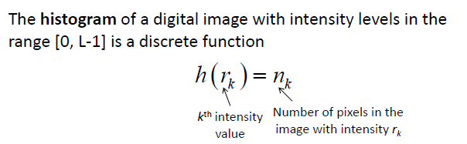
Image Enhancement: Histogram Based Methods
What is the histogram of a digital image?

Slide 3
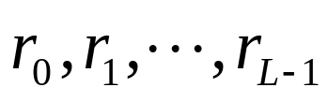
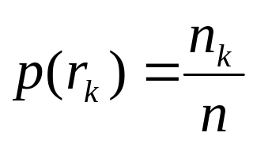
• The histogram of a digital image with gray values
is the discrete function
n_{k}: Number of pixels with gray value r_{k}
n: total Number of pixels in the image
• The function p(r_{k}) represents the fraction of the total number of pixels with gray value r_{k}.

Slide 4
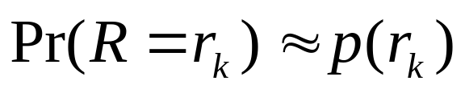
• Histogram provides a global description of the appearance of
the image.
• If we consider the gray values in the image as realizations of a
random variable R, with some probability density, histogram
provides an approximation to this probability density. In other
words,

Slide 5
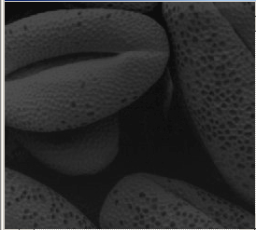
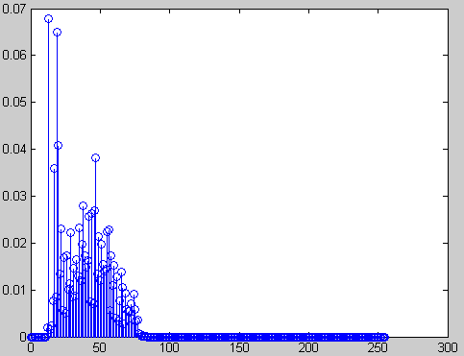
Some Typical Histograms
• The shape of a histogram provides useful information for
contrast enhancement.
Dark image

Slide 6
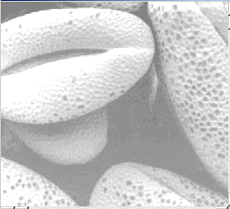
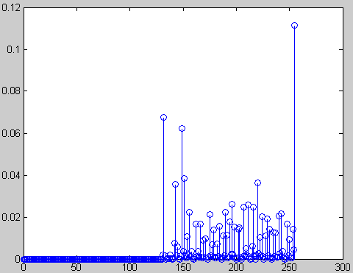
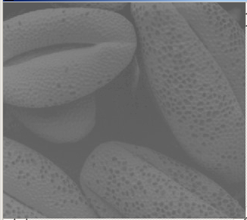
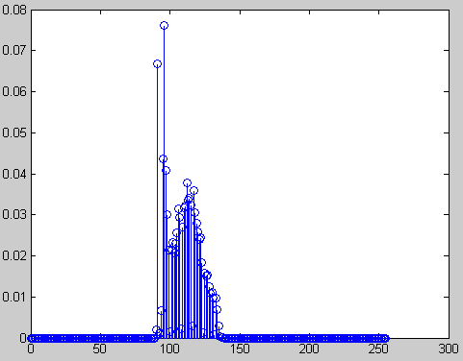
Bright image
Low contrast image

Slide 7
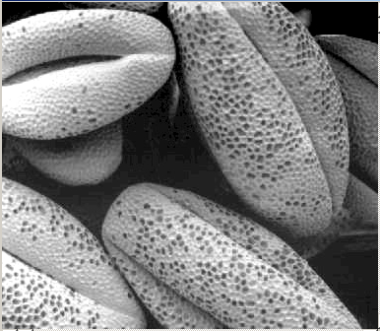
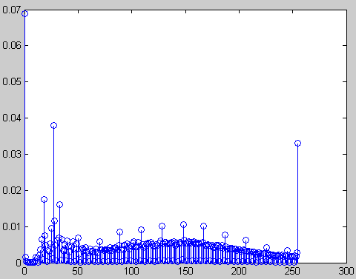
High contrast image

Slide 8
Histogram Equalization
• What is the histogram equalization?
• Τhe histogram equalization is an approach to enhance a given image. The approach is to design a transformation T(.) such that the gray values in the output is uniformly distributed in [0, 1].
• Let us assume for the moment that the input image to be
enhanced has continuous gray values, with r = 0 representing
black and r = 1 representing white.
• We need to design a gray value transformation s = T(r), based
on the histogram of the input image, which will enhance the
image.

Slide 9
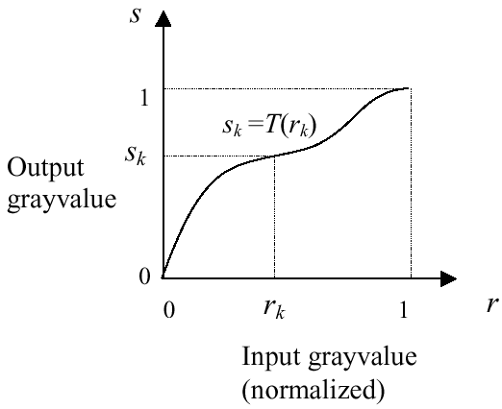
• As before, we assume that:
(1) T(r) is a monotonically increasing function for 0 ≤ r ≤ 1 (preserves order from black to white).
(2) T(r) maps [0,1] into [0,1] (preserves the range of allowed
Gray values).

Slide 10
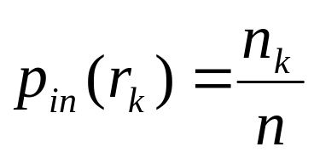


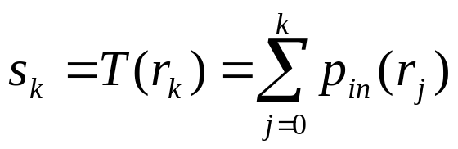
How to implement histogram equalization?
Step 1:For images with discrete gray values, compute:
L: Total number of gray levels
n_{k}: Number of pixels with gray value r_{k}
n: Total number of pixels in the image
Step 2: Based on cumulative distribution function (CDF), compute the discrete version of the previous transformation :

Slide 11
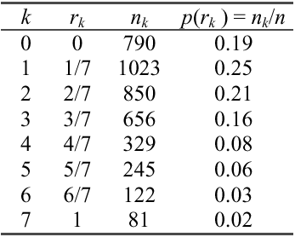
Example:
• Consider an 8-level 64 x 64 image with gray values (0, 1, …,
7). The normalized gray values are (0, 1/7, 2/7, …, 1). The
normalized histogram is given below:
NB: The gray values in output are also (0, 1/7, 2/7, …, 1).

Slide 12
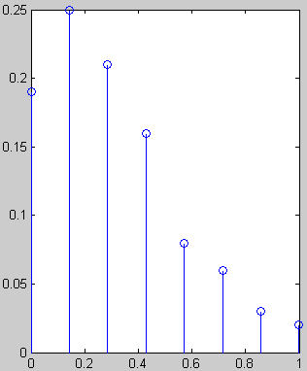
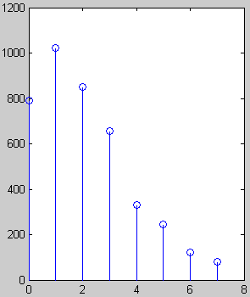
# pixels
Fraction of # pixels
Gray value
Normalized gray value

Slide 13
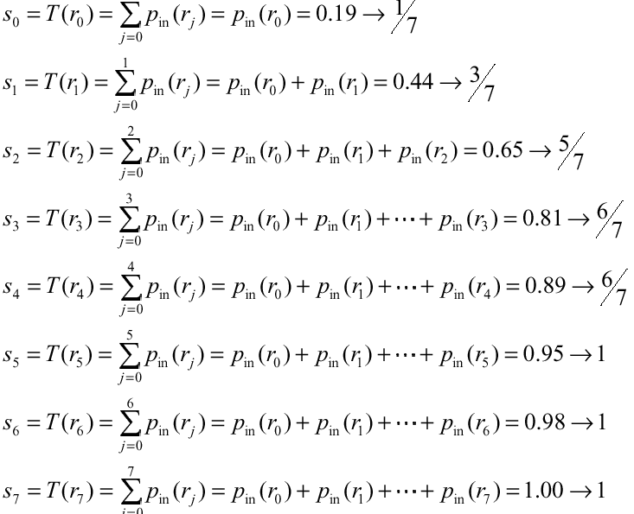
• Applying the transformation,
we have

Slide 14
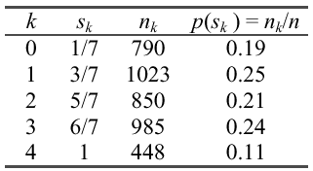
• Notice that there are only five distinct gray levels --- (1/7, 3/7,
5/7, 6/7, 1) in the output image. We will relabel them as (s₀,
s₁, …, s₄ ).
• With this transformation, the output image will have
histogram

Slide 15
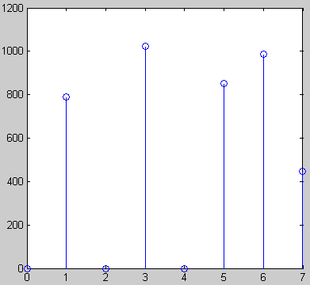
Histogram of output image
# pixels
Gray values
• Note that the histogram of output image is only approximately, and not exactly, uniform. This should not be surprising, since there is no result that claims uniformity in the discrete case.

Slide 16
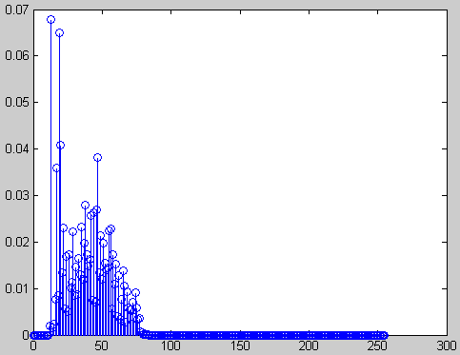
Original image and its histogram
Example

Slide 17
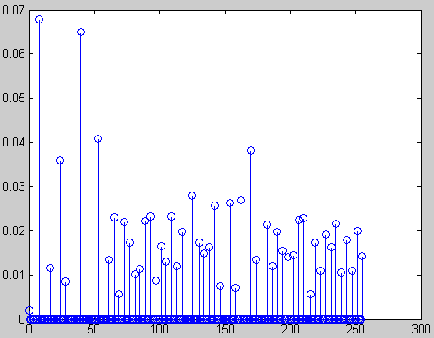
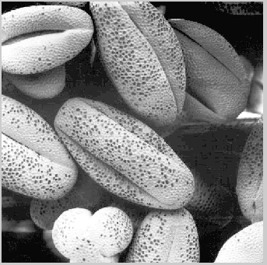
Histogram equalized image and its histogram

Slide 18
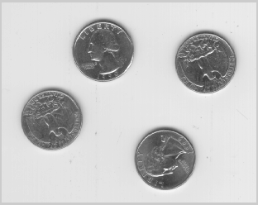
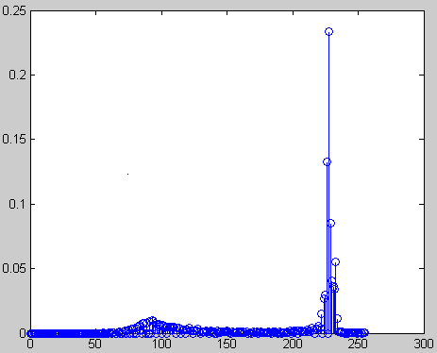
• Comments:
Histogram equalization may not always produce desirable
results, particularly if the given histogram is very narrow. It
can produce false edges and regions. It can also increase
image “graininess” and “patchiness.”

Slide 19
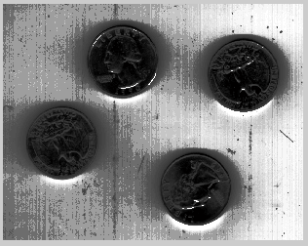
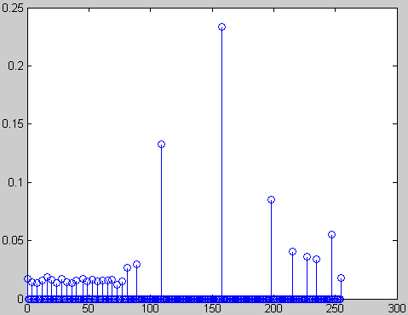

Slide 20
Histogram Specification
(Histogram Matching)
• Histogram equalization yields an image whose pixels are (in
theory) uniformly distributed among all gray levels.
• Sometimes, this may not be desirable. Instead, we may want a
transformation that yields an output image with a pre-specified
histogram. This technique is called histogram specification.

Slide 21
• Given Information
(1) Input image from which we can compute its histogram .
(2) Desired histogram.
• Goal
Derive a point operation, H(r), that maps the input image into an output image that has the user-specified histogram.
• Again, we will assume, for the moment, continuous-gray values.

Slide 22
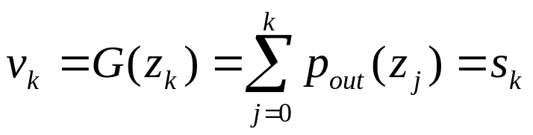
Algorithm for histogram specification:
(1) Equalize input image to get an image with uniform gray values, using the discrete equation:
(2) Based on desired histogram to get an image with uniform gray values, using the discrete equation:
(3)
z
=
G
−
1
(
v=s
)
→
z
=
G
−
1
[
T
(
r
)]

Slide 23
Example:
• Consider an 8-level 64 x 64 previous image.
# pixels
Gray value

Slide 24
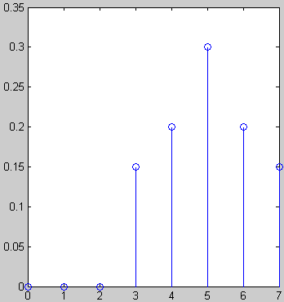
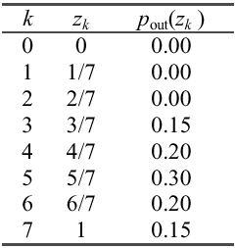
• It is desired to transform this image into a new image, using a transformation Z=H(r)= G⁻¹[T(r)], with histogram as specified below:
# pixels
Gray values

Slide 25
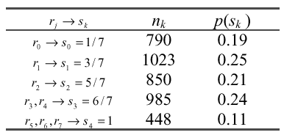
• The transformation T(r) was obtained earlier (reproduced
below):
• Now we compute the transformation G as before.

Slide 26
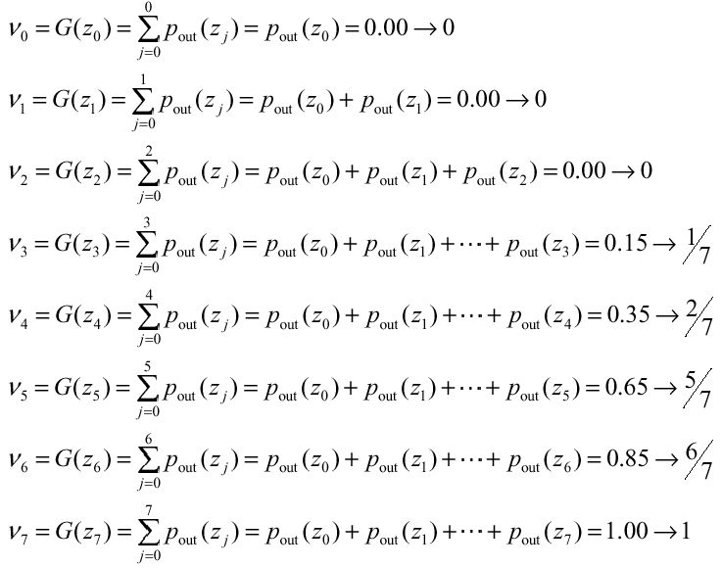

Slide 27
• Compute z=G⁻¹ (s), Notice that G is not invertible.
G⁻¹(0) = ?
G⁻¹(1/7) = 3/7
G⁻¹(2/7) = 4/7
G⁻¹(3/7) = ?
G⁻¹(4/7) = ?
G⁻¹(5/7) = 5/7
G⁻¹(6/7) = 6/7
G⁻¹(1) = 1

Slide 28
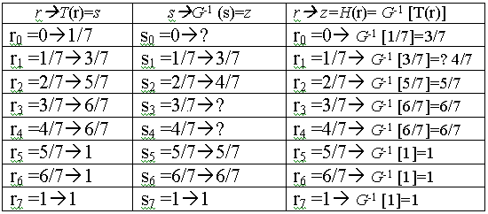
• Combining the two transformation T and G⁻¹ , compute z=H(r)= G⁻¹[v=s=T(r)]

Slide 29
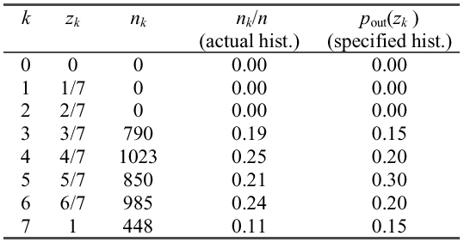
• Applying the transformation H to the original image yields an image with histogram as below:
• Again, the actual histogram of the output image does not exactly but only approximately matches with the specified histogram. This is because we are dealing with discrete histograms.

Slide 30
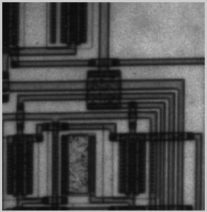
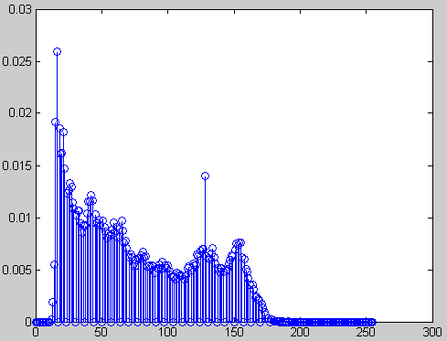
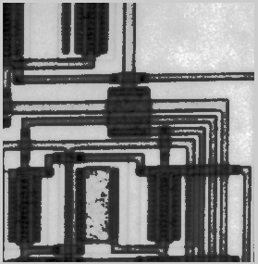
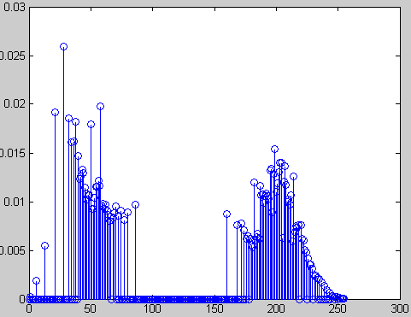
Original image and its histogram
Histogram specified image and its histogram

